Slide 1
ANALYZING NEWS using NLP TECHNIQUES

Slide 2
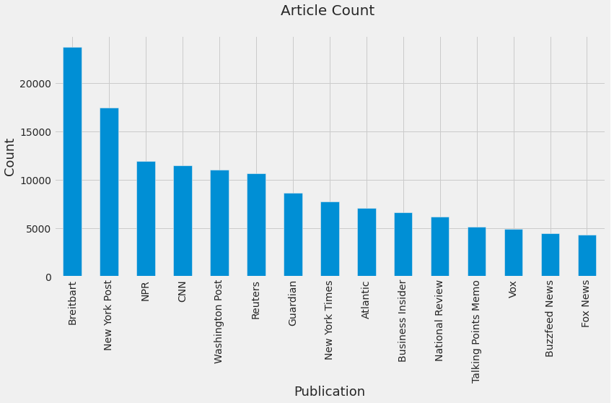
overview
Objective
Capture important events that occurred during the timeframe of these articles, and how they changed overtime ?
Analyze ways that can inform stakeholders of strategic business decisions.
About the dataset
Dataset has ~ 143000 articles
99.7% of articles are between 2015-2017
Distribution of articles by publisher is skewed

Slide 3
HIGH LEVEL APPROACH
Pre-process articles
Convert text to word counts
Convert text to vector of term frequencies
Remove punctuations
Explore dataset
Remove undecipherable text
Remove noise
Visualize trends
Keyword search functionality to find relevant articles that give business insights

Slide 4



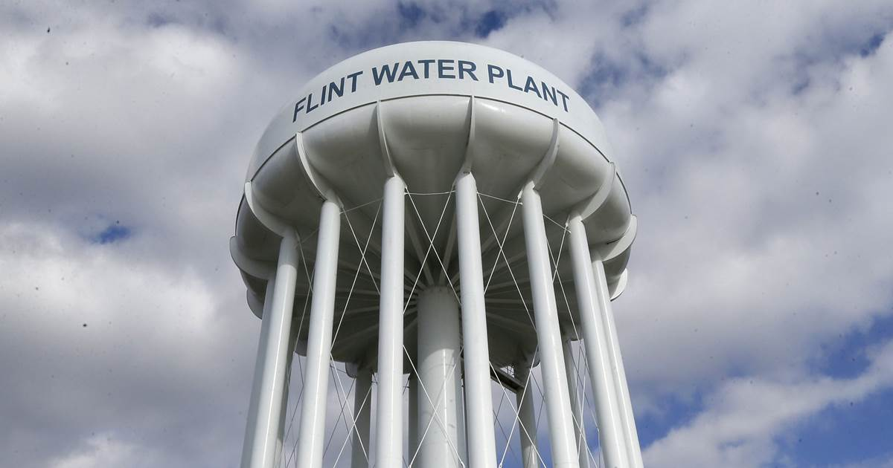
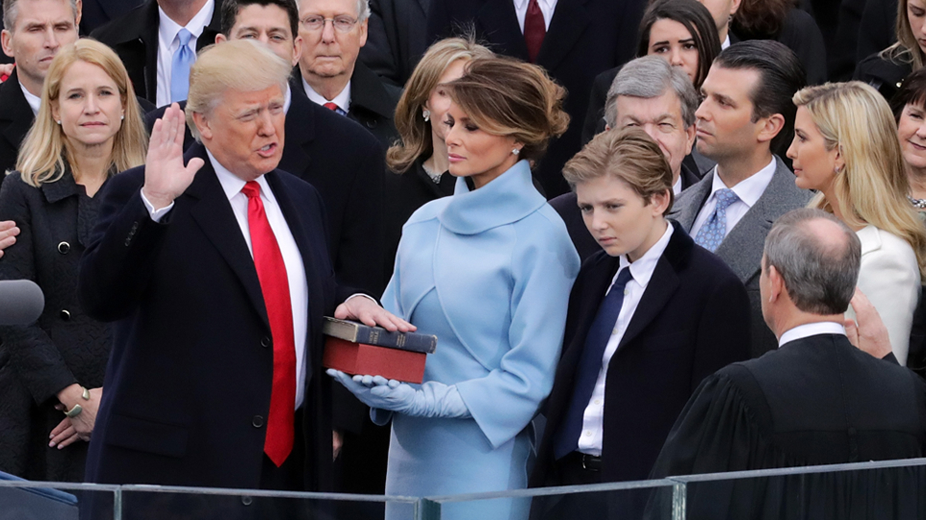

FINDINGS – MAJOR EVENTS
2015
Boston Bomb Trial
Aaron Hernandez Murder
South Carolina Shooting
Charlie Hebdo attack
Women’s World Cup
Climate Change agreement
2016
Donald Trump won
Gun Control debate (most likely due to Orlando shooting)
Flint Water Crisis (state of emergency was declared in Geneses county)
While across 2015-2016, and 2016-2017 we see a theme of some of the issues being consistently reported in news like - Black Lives Matter movement
South China Sea issue
Iran Nuclear Deal
Police officer shooting
2017
Trump Immigration Ban
La la Land released
Dakota access pipeline issue
White House Correspondent Dinner
Marine Le Pen – French presidential election

Slide 5
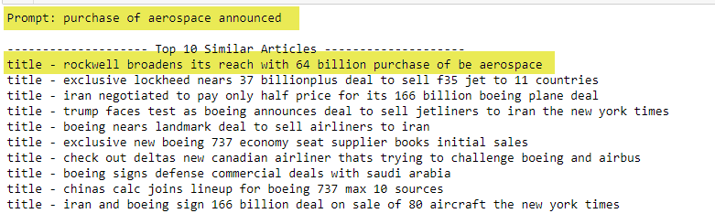
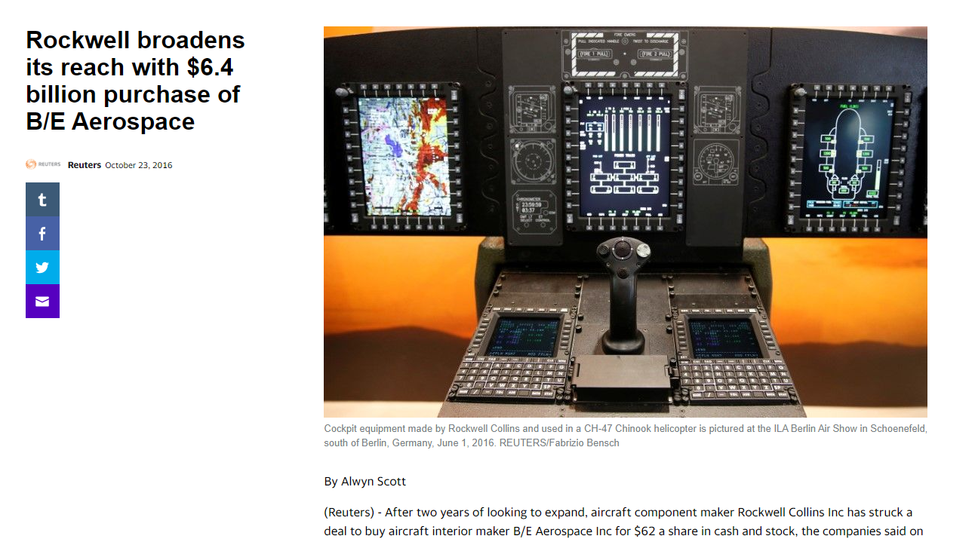
Searching relevant news
How this can help?
As seen in the right image, given a search term I was able to pull relevant articles, which now a stakeholder can make informed strategic business decision that might affect Lockheed given announcement of Rockwell’s billion-dollar purchase of B/E Aerospace.
What else can we do?
We can filter out competitors, or suppliers, or tech companies and built a robust tool to monitor daily news based on this underlying technique.

